Slide 1
Lecture 27: Conversion of PDA to CFG
Agenda:
PDA to CFG Conversion
Steps
Example
Presented by
Prof. Vaibhav Narayan Chunekar
K. J. Somaiya College of Engineering, Vidyavihar, Mumbai

Slide 2
Rules of Conversion PDA -CFG
The production in P is induced by moves of PDA are as follows:
S productions are given by
S→ ( q0 z q ) for every q ∈ Q
For every popping up move
δ ( q, a,z)= q’, λ induced production
[ q z q’ ]→a
For each push moves
δ ( q, a, z)= q1, z1,z2,z3...... Z_{m} induced by many productions
[q z,q’]→a[q1,z1,q2] [q2 ,z2,q3] [q3,z3,q4]............[qm,zm,q’]
Where each state q1,q2,q3........qm are the states in Q

Slide 3
Example : Convert the CFG for given PDA M is defined are as follows:
M={ {q0,q1}, {0,1}, {x,z0), δ, q0, z0, q1}
δ :
δ (q0,1,z0)→q0,xzo
δ (q0,1,x)→q0,xx
δ (q0,0,x)→q0,x
δ (q0,ε,x)→q1, ε
δ (q1, ε, x)→q1, ε
δ (q1, 0,x)→q1,xx
δ (q1,0,z)→q1, ε

Slide 4
Apply Rule 1
S→ [ q0 z0 q0]==A
S→ [ q0 z0 q1]==B
Or
S→A/B

Slide 5
Transition 1: Apply Rule 3: Push Element
δ (Q0,1,z0)→q0,xzo(4 Productions)
Q0 z0 q0 | →1 | Q0 x q0 | q0 z0 q0
Q0 z0 q0 | →1 | Q0 x q1 | q1 z0 q0
Q0 z0 q1 | →1 | Q0 x q0 | q0 z0 q1
Q0 z0 q1 | →1 | Q0 x q1 | q1 z0 q1

Slide 6
2nd transition: Apply Rule 3: Push Element
δ (q0,1,x)→q0,xx
Q0 x q0 | →1 | Q0 x q0 | Q0 x q0
Q0 x q0 | →1 | Q0 x q1 | q1 x q0
Q0 x q1 | →1 | Q0 x q0 | q0 x q1
Q0 x q1 | →1 | Q0 x q1 | q1 x q1

Slide 7
3 transition: Apply Rule 3: Push Element
δ (q0,0,x)→q0,x
q0 x qo | →0 | q0 x q0
q0 x q1 | →0 | q0 x q1

Slide 8
Transition 4: Apply Popping Move
δ (q0,ε,x)→q1, ε
q0 x q1 | → ε

Slide 9
Transition 5: Apply Popping Move
δ (q1, ε, x)→q1, ε
q1 x q1 | → ε

Slide 10
Transition 6: Apply Rule 3: Push Element
δ (q1, 0,x)→q1,xx
Q1 x q0 | →0 | Q1 x q0 | Q0 x q0
Q1 x q0 | →0 | Q1 x q1 | q1 x q0
Q1 x q1 | →0 | Q1 x q0 | q0 x q1
Q1 x q1 | →0 | Q1 x q1 | q1 x q1

Slide 11
Transition 7: Apply Popping Move
δ (q1,0,z0)→q1, ε
q1 z0 q1 | → 0

Slide 12
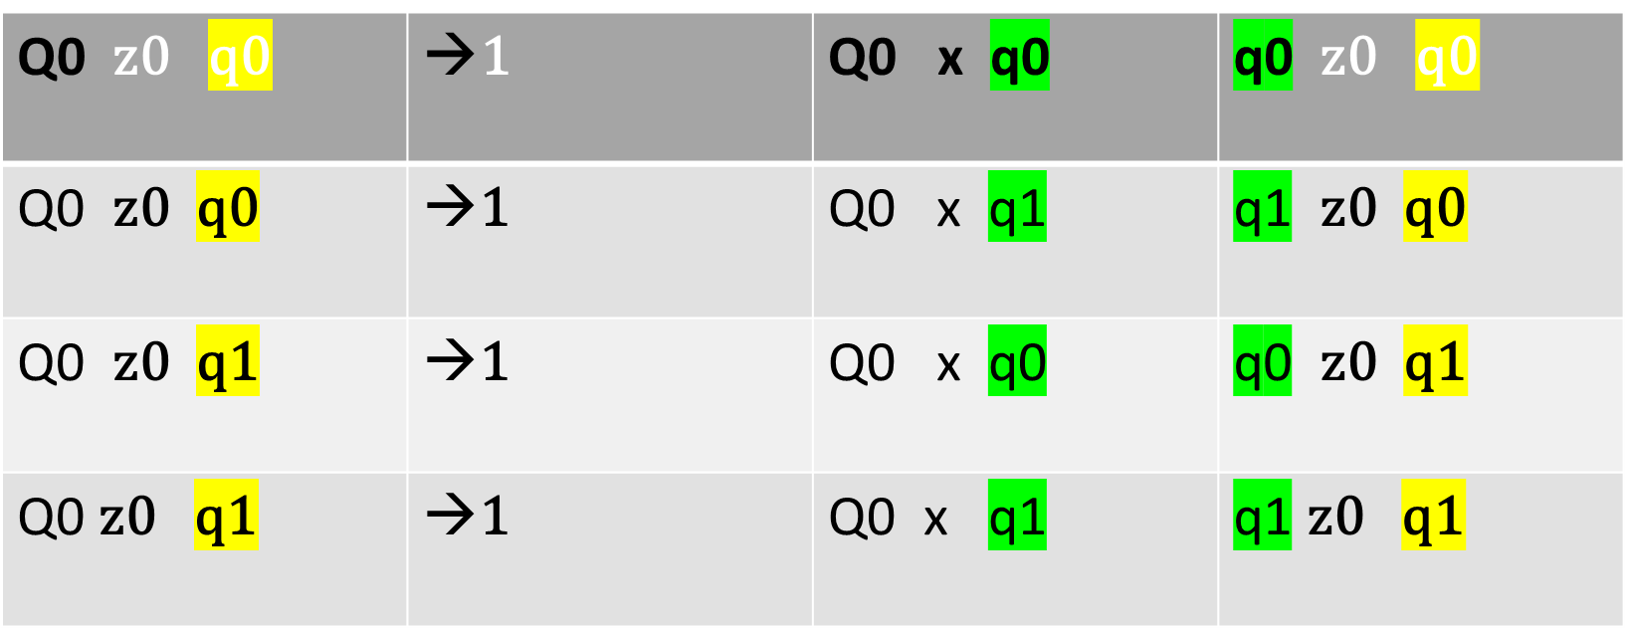
Final CFG
S→ [ q0 z0 q0]
S→ [ q0 z0 q1]

Slide 13
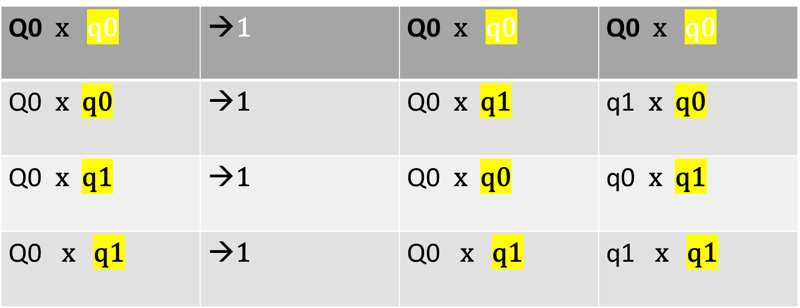
Final CFG

Slide 14
Final CFG
q0 x qo | →0 | q0 x q0
q0 x q1 | →0 | q0 x q1
q0 x q1 | → ε
q1 x q1 | → ε

Slide 15
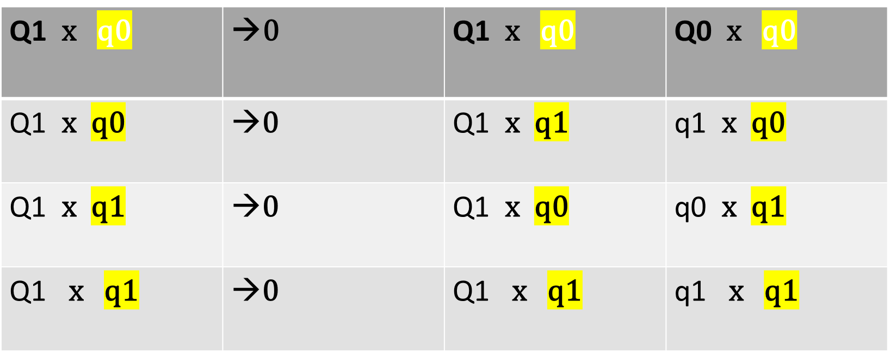
Final CFG

Slide 16
Final CFG
q1 z0 q1 | → 0

